Slide 1
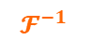
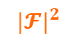
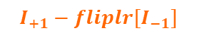
Figure 1. Workflow
OAM +1
OAM -1
$${|𝓕|}^{2}$$
$$I_{+1}−fliplr[I_{−1}]$$
$$𝓕^{−1}$$

Slide 2
Figure 2. Common Defects
Notes:
Missing contact / a spot in subplot(232)

Slide 3
Figure 3-1. Noise Analysis

Slide 4
Figure 3-2. Noise Analysis

Slide 5
Figure 4. Varying OAM

Slide 7
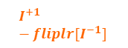
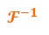
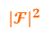
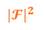
OAM +1
OAM -1
$${|𝓕|}^{2}$$
$${|𝓕|}^{2}$$
$$I^{+1}−fliplr[I^{−1}]$$
$$𝓕^{−1}$$

Slide 8
OAM +1
OAM -1

Slide 9
OAM +1
OAM -1

